Slide 1
Spotify Trend Analysis
File created on: 6/24/2023 12:04:13 AM

Slide 2
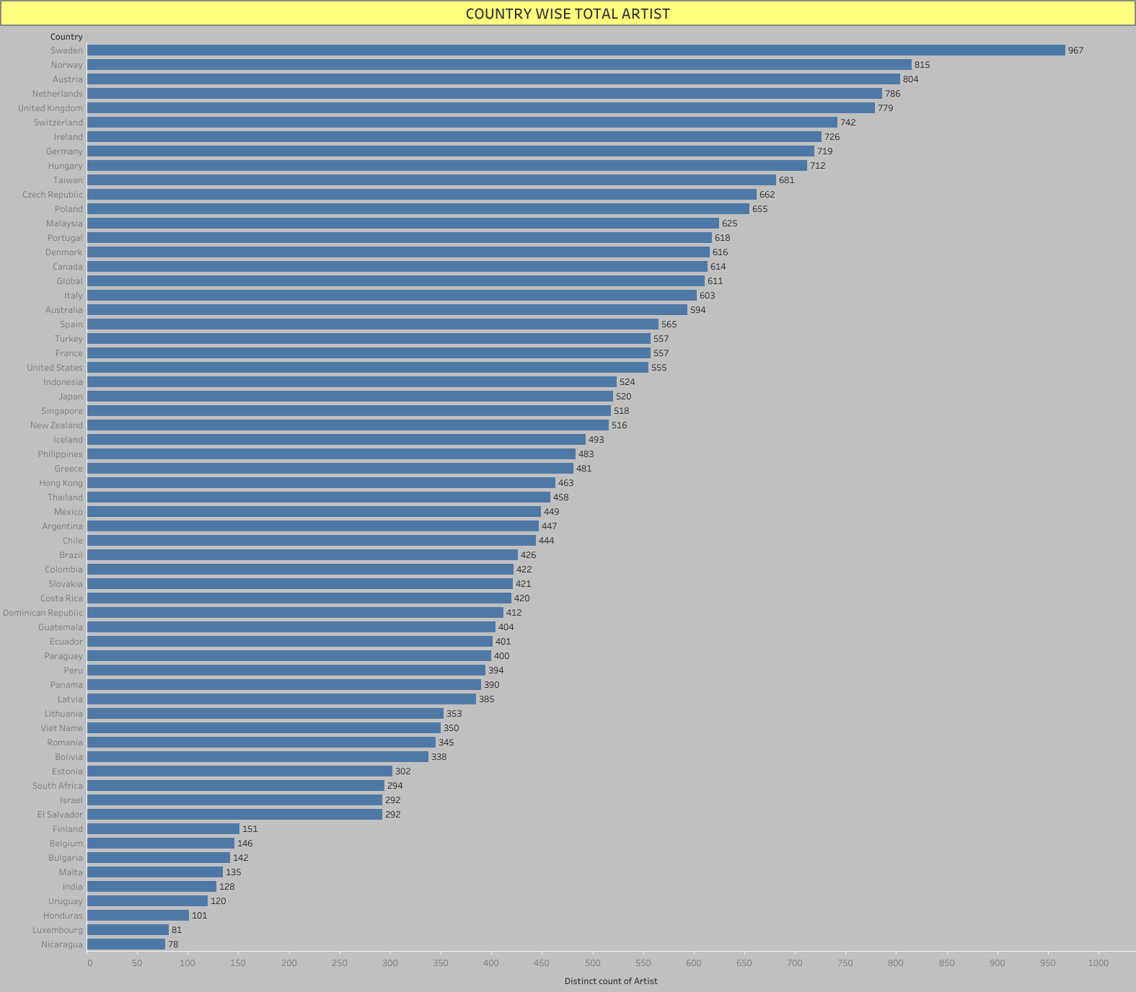

Slide 3
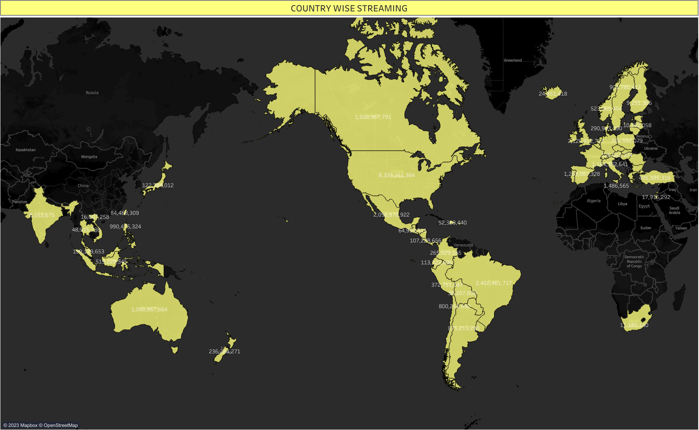

Slide 4
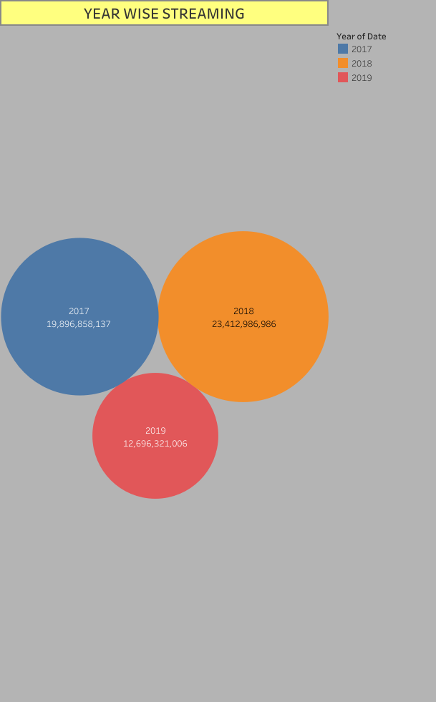

Slide 5


Slide 6


